Slide 1
Final Project Group “H”
House Prices - Advanced Regression Techniques
SATYBALDIEVA BAKTYGUL
FOZILOV ELDOR
KURMANGALI AIDA
ZHOLDASSOVA BOTAGOZ

Slide 2
CONTENTS
Problem Statement
Data Exploration and Preprocessing
Methodologies: processes and parameters
Results
Implications

Slide 3
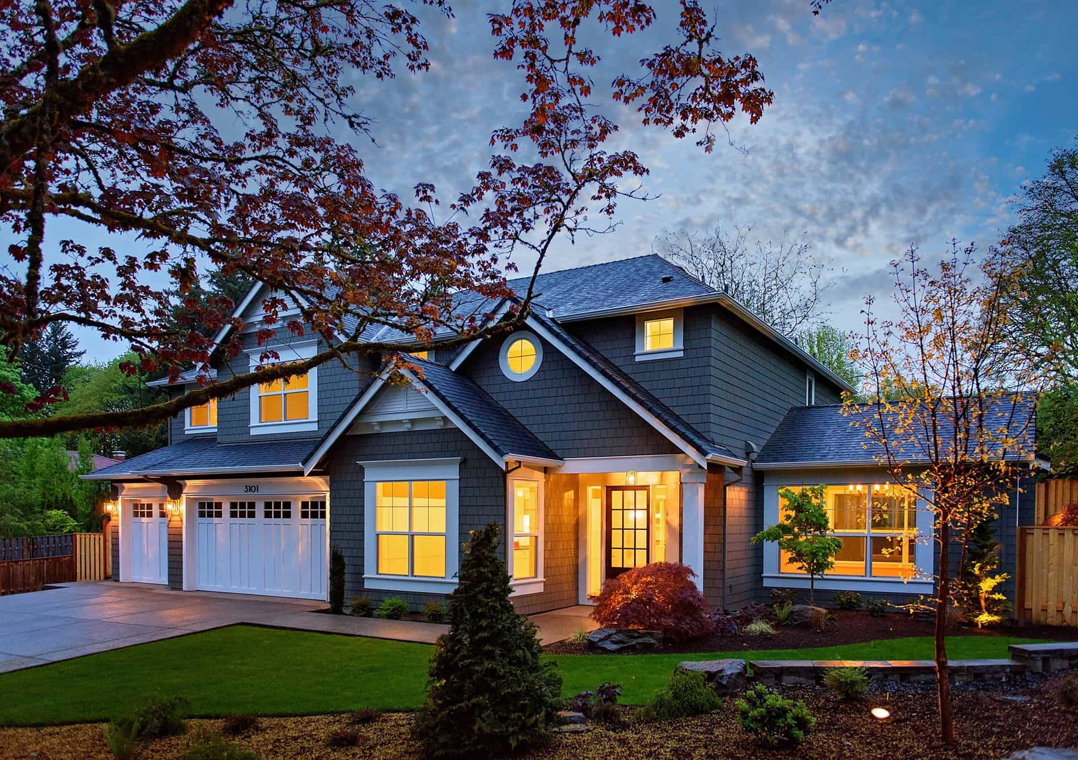


PROBLEM STATEMENT
If we ask a home buyer to describe their dream house, and they probably won't begin with the height of the basement ceiling or the proximity to an east-west railroad.
With 79 explanatory variables describing (almost) every aspect of residential homes this project challenged our team to predict the final price of each home.

Slide 4
Data Exploration and Analysis

Slide 5
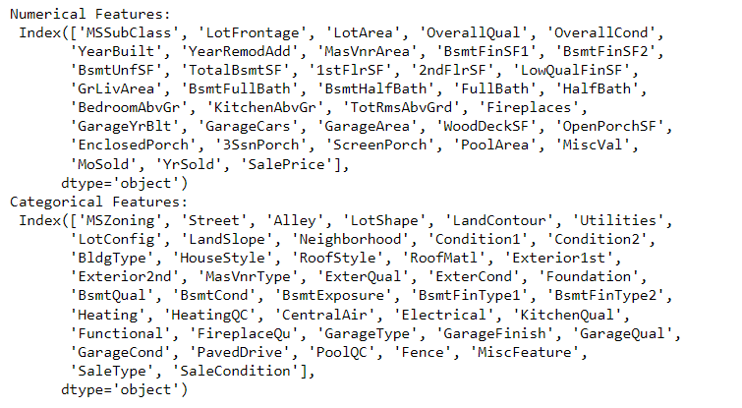
Data Munging
Number of samples: 1460
Categorical variables: 43
Numerical variables: 36 + 1
The features that we use are: type of dwelling involved in the sale, neighbourhood, lot size in square feet, rate of overall material of a house, materials that are used, heating and air conditioning and etc.
Our main goal is to predict a house’s sale price, using its available features
All of the features in the dataset, including the target (SalePrice)

Slide 6
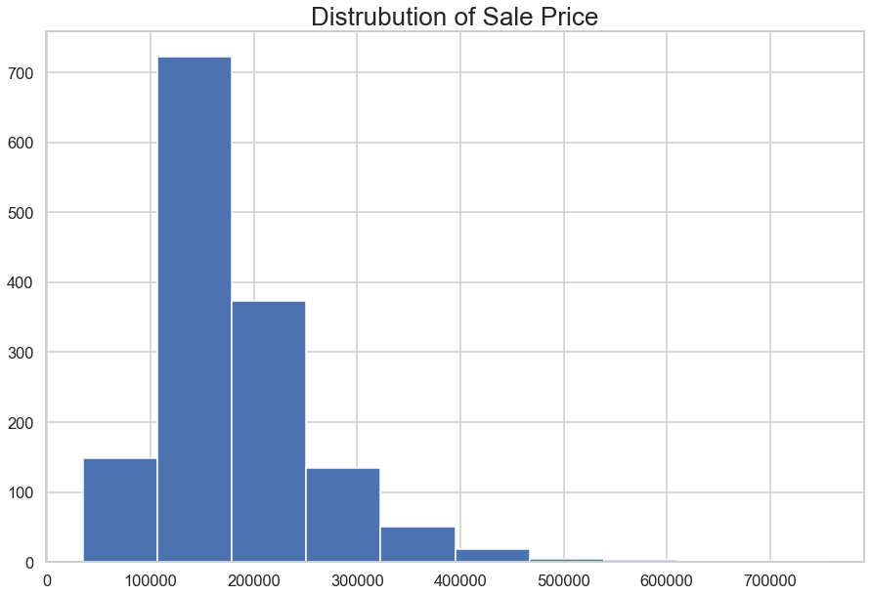
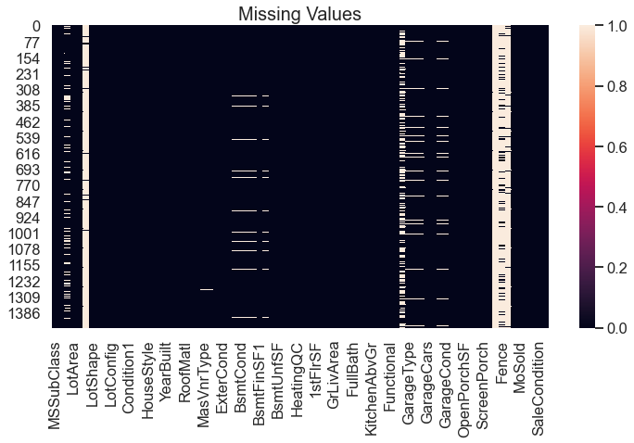
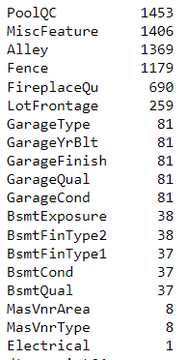
Target Info and Missing Values

Slide 7
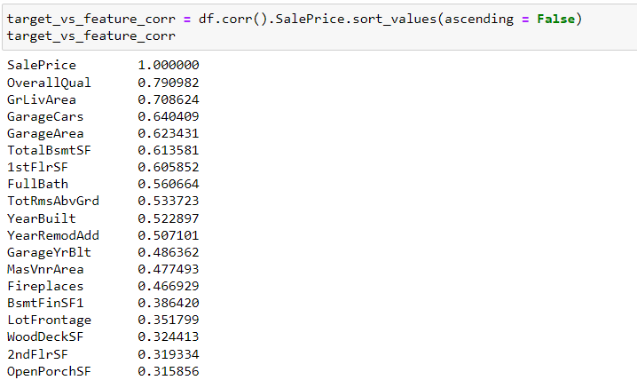
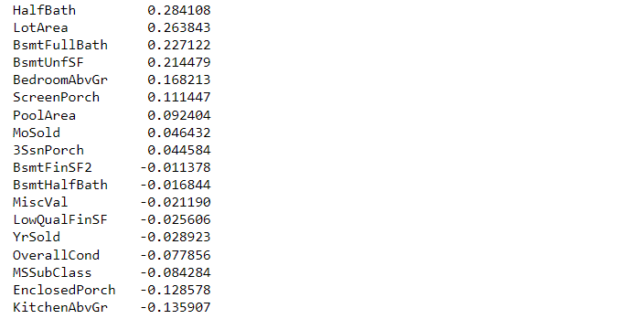
Correlation between Numerical Predictors and the Target

Slide 8
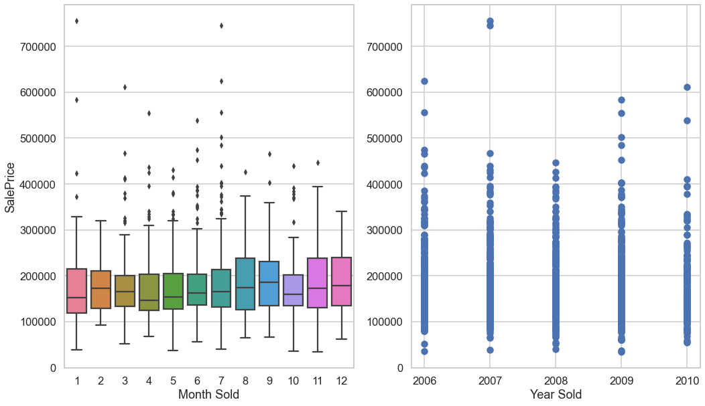
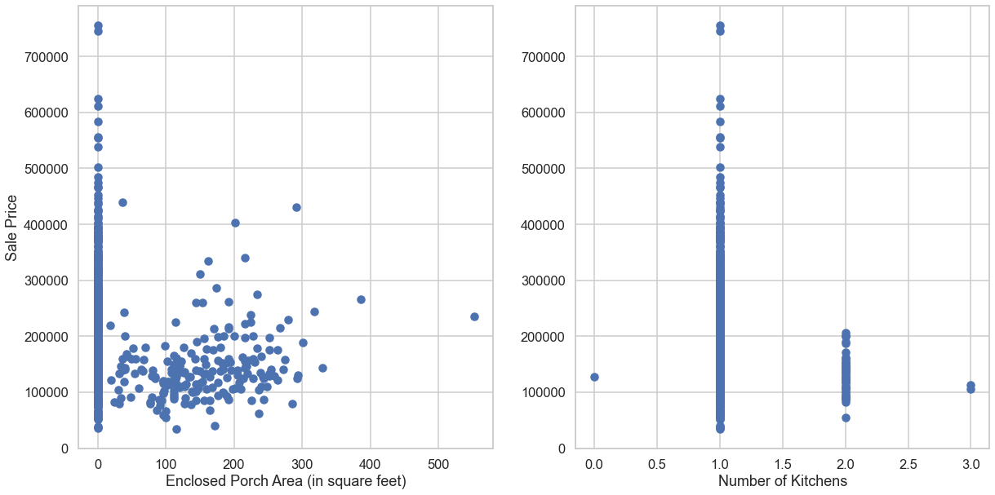
Exploratory Data Analysis (EDA)
These two variables seem to be informative, thus we will not drop them even if they have a negative correlation with the target variable.
We can see that above two variables are not informative. Thus we will drop them

Slide 9
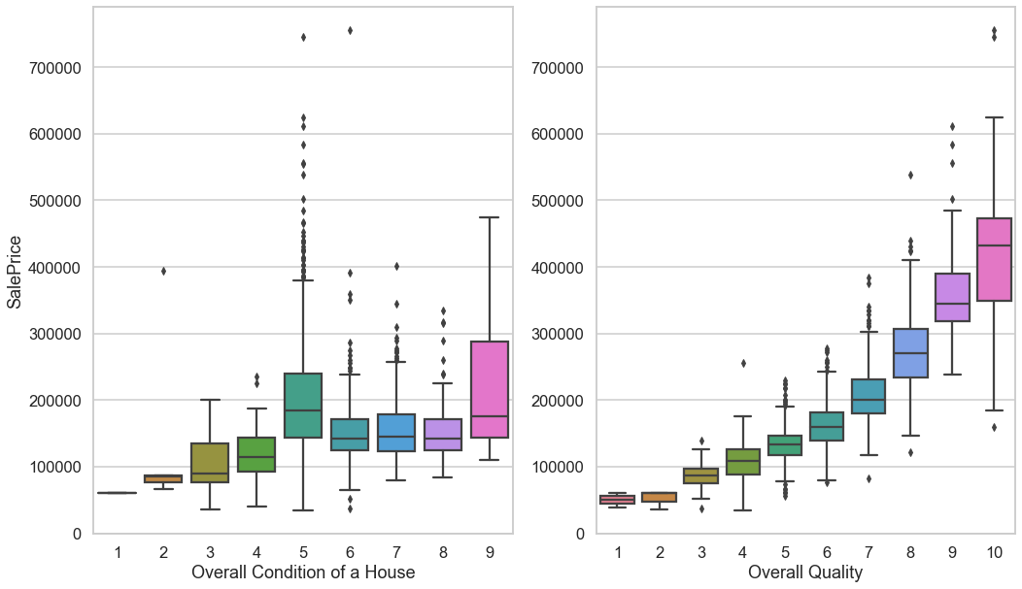
Exploratory Data Analysis (EDA)
We can see that the variable related to overall "condition" of a house does not show what we expected, while the other variable related overall "quality" of a house give us what we expected. Thus we will not consider the former variable in our analysis.

Slide 10
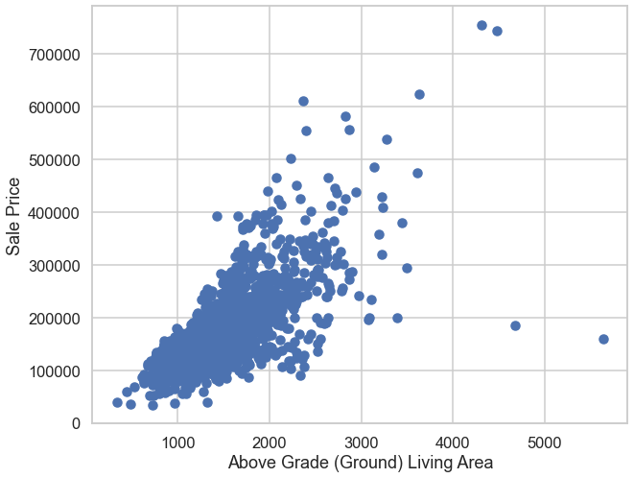
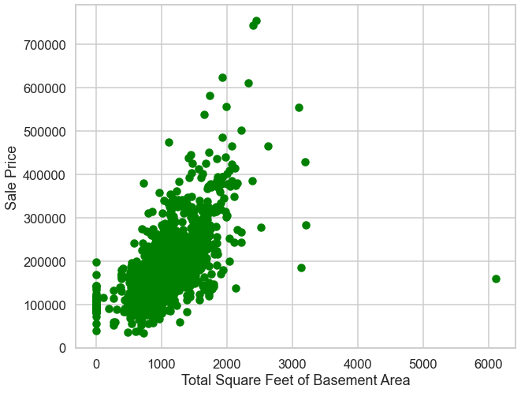
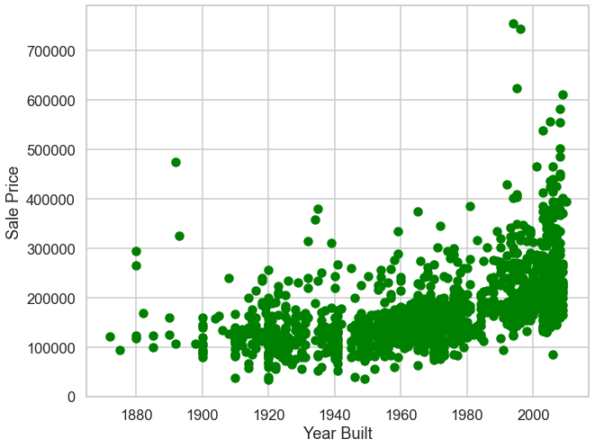
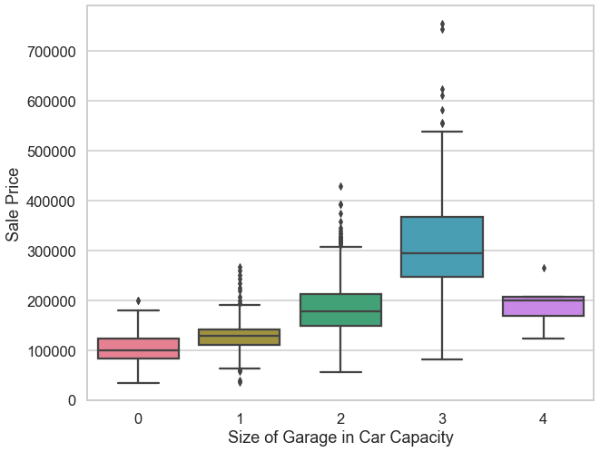
Exploratory Data Analysis (EDA)

Slide 11
Data Preprocessing

Slide 12
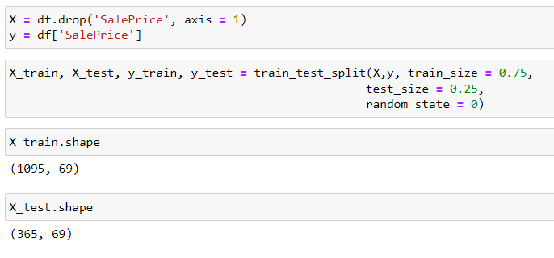
Splitting Data into Train and Test Set
25% - Test set
75% - Training set

Slide 13
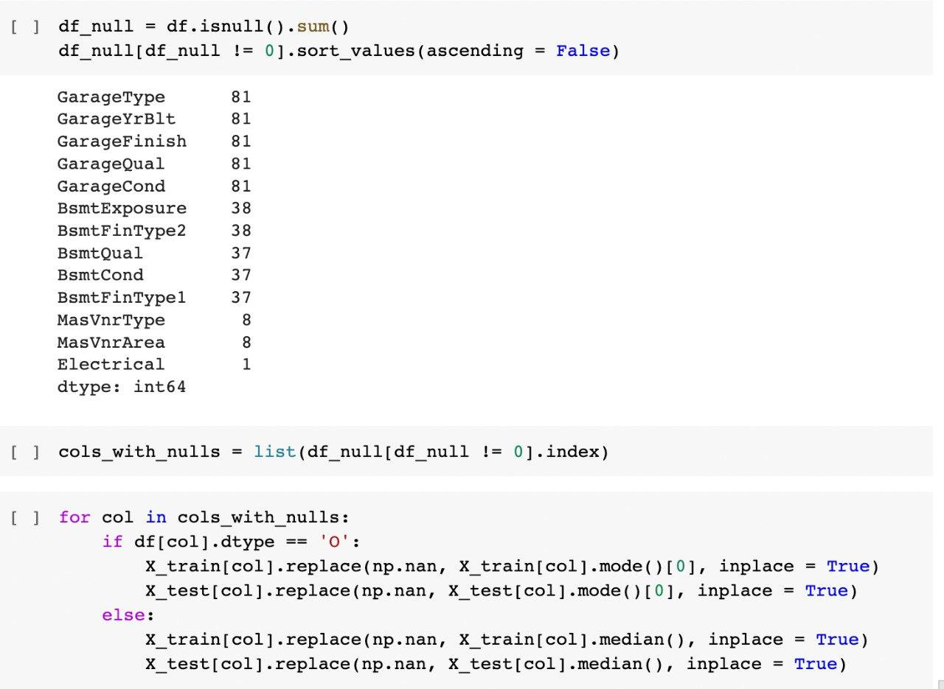
Replacing Missing Values
If a variable is categorical, we replace a missing value with the mode.
If a variable is numerical, we replace a missing value with the median.
We do it separately for the training set and the test set to avoid data leakage.

Slide 14
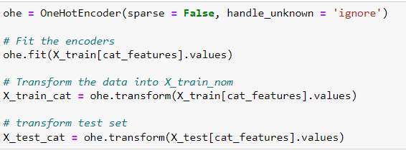
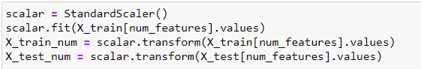
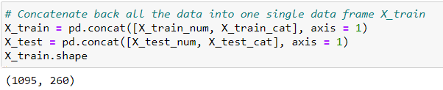
Encoding and Scaling
We applied one-hot encoding to transform categorical variables into
dummy variables.
We applied standard scaling to transform numerical variables.
Here we combined all of the transformed variables.
We did feature scaling separately for the test set and train set to avoid data leakage.

Slide 15
Model Training and Evaluation

Slide 16
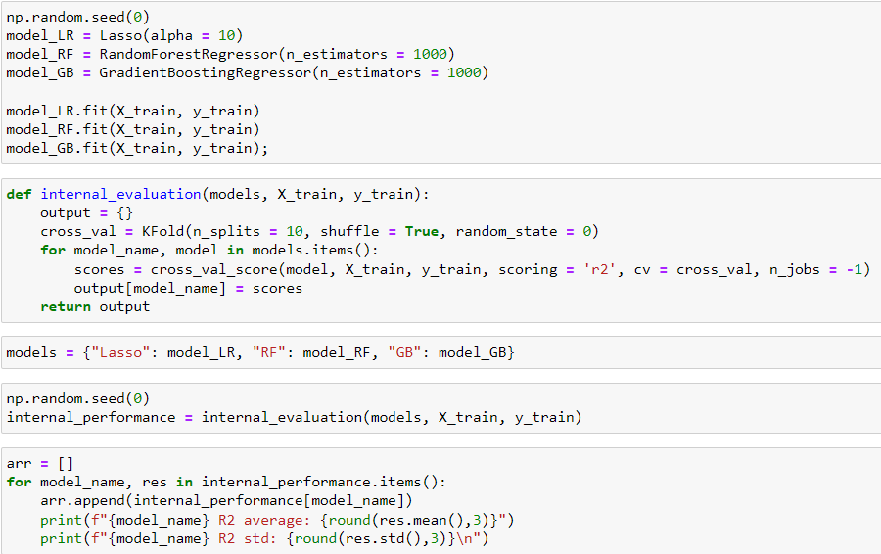
Model Training and Evaluation
We are going to use the following three regression algorithms for our dataset:
Lasso Regression, Random Forest, Gradient Boost
Lasso R2 average: 0.85
Lasso R2 std: 0.123
RF R2 average: 0.84
RF R2 std: 0.097
GB R2 average: 0.829
GB R2 std: 0.165

Slide 17
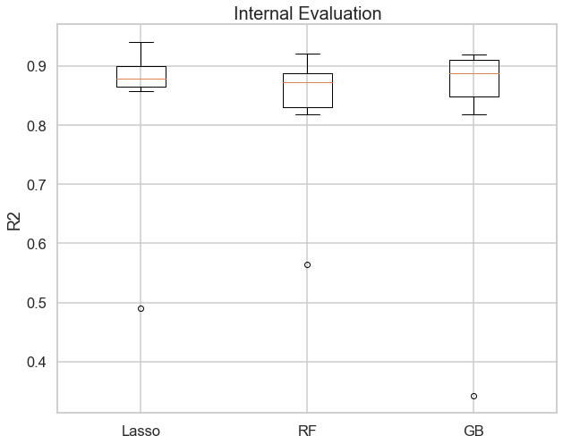
Model Training and Evaluation
plt.figure(figsize = (10,8))
plt.boxplot(arr, labels = list(internal_performance.keys()))
plt.ylabel('R2')
plt.title("Internal Evaluation", fontsize = 20)
plt.show()

Slide 18
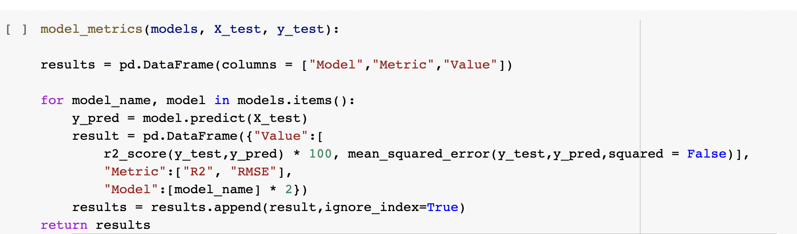
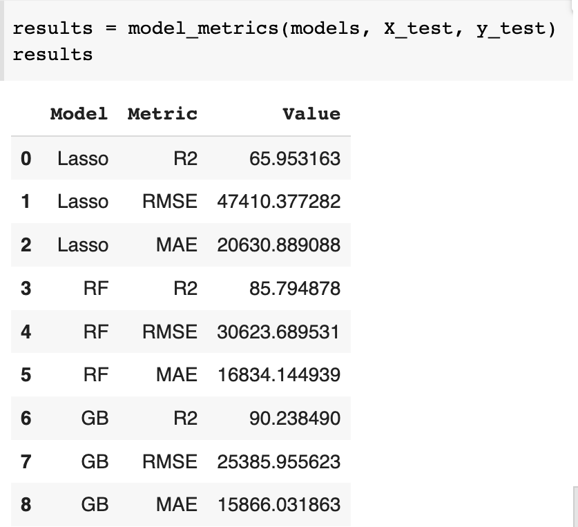
RESULTS

Slide 19
Results and Implications

Slide 20
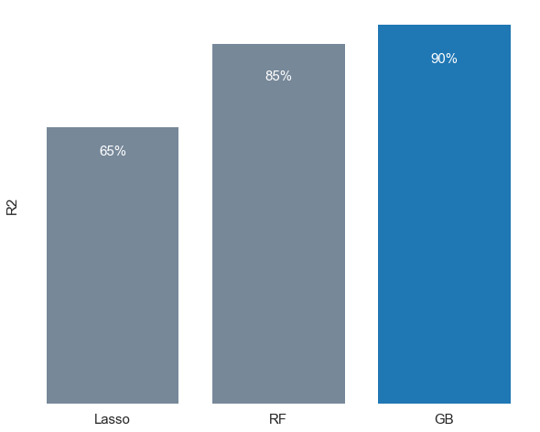
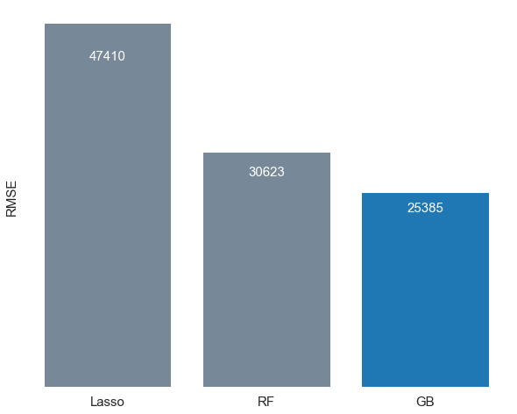
RESULTS (R2 and RMSE)

Slide 21
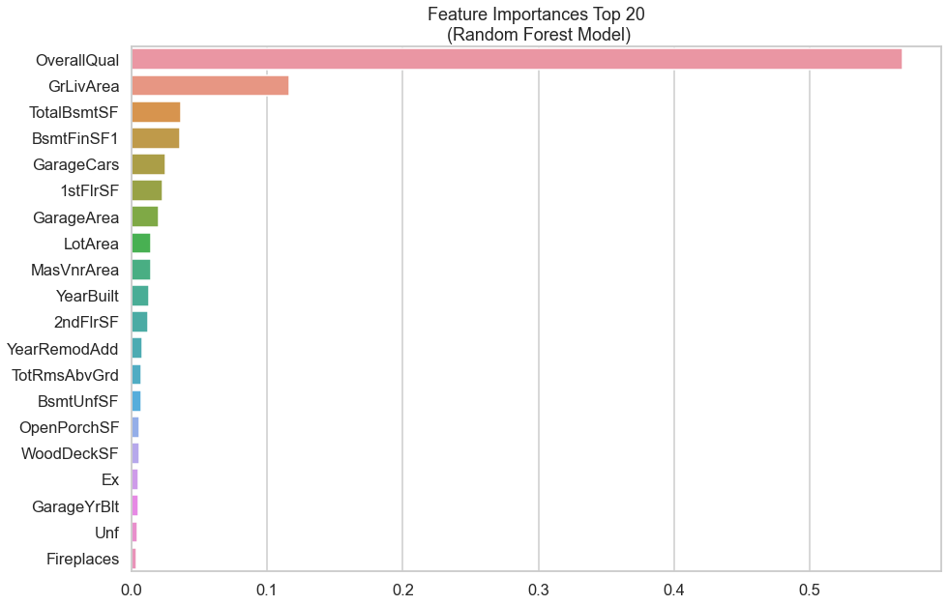
RF Feature importance
Most important features:
Overall material and finish of a house
Above grade (ground) living area square feet
Total square feet of basement area
Size of garage
First Floor square feet
Lot Area in square feet
Year Built

Slide 22
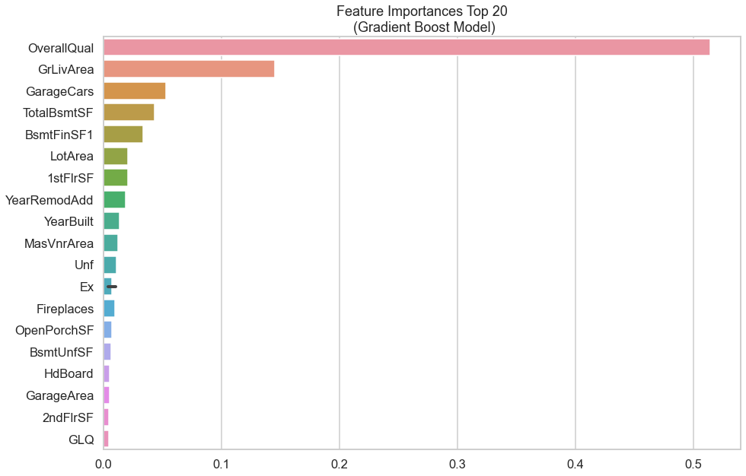
GB Feature Importance
Most important features:
Overall material and finish of a house
Above grade (ground) living area square feet
Total square feet of basement area
Size of garage
First Floor square feet
Lot Area in square feet
Year Built

Slide 23
Thank you!

